Slide 1
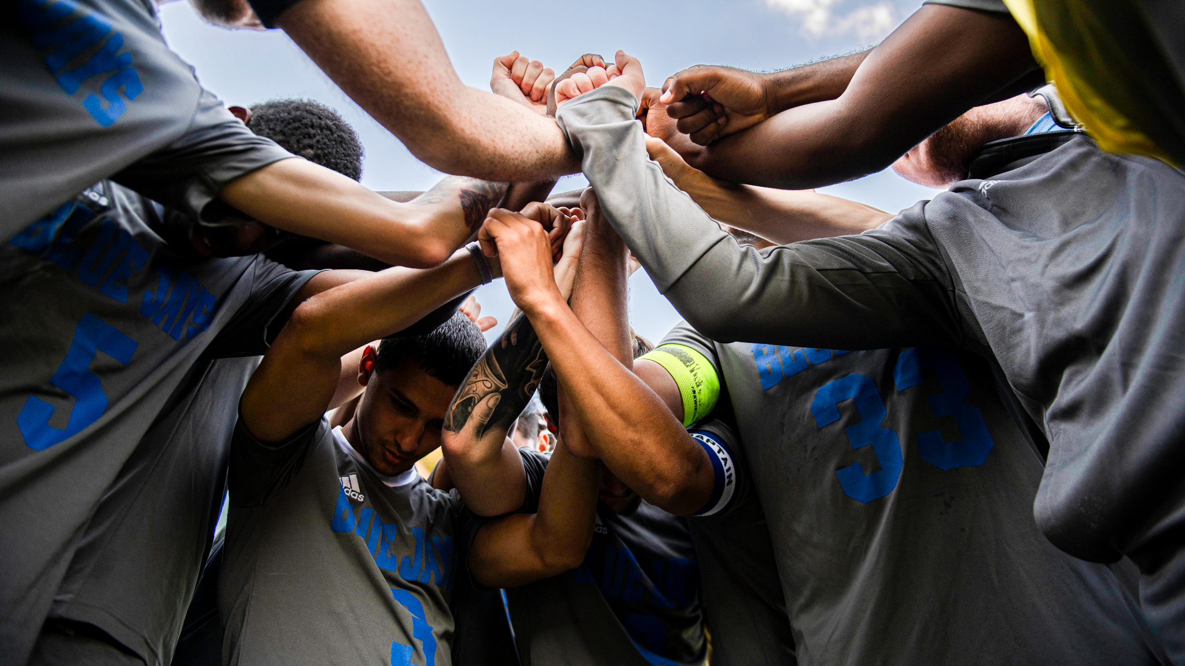
Be A Strong Student
Fall 2024
Notes:
Instructors: You can pull these in a number of different ways: If you use Google Slides, go to File/Make a Copy and then you have your own set of slides. You can click an individual slide on the left nav, hit Ctrl C, and then go to your own slides and hit Ctrl V. It’ll pop in. Tips: https://slideuplift.com/blog/how-to-duplicate-copy-paste-a-slide-in-google-slides/.
If you use Powerpoint, go to File/Download and save to your own computer. You can then copy individual slides into your presentation. Tips: https://support.microsoft.com/en-us/office/copy-and-paste-your-slides-1fe39ace-4df6-4346-b724-30a6e2c0aeab

Slide 2
You Belong Here: Info for Instructors
A diverse array individuals representing many departments and programs at Manor College developed this campaign to raise awareness of the behaviors and actions that STRONG students develop and practice.
All Blue Jays can be STRONG students! Blue Jays can soar to new heights! This campaign makes explicit what it takes to become STRONG – it’s small, simple acts that, in total, lead to success.
Instructors are invited and encouraged to support this campaign:
During each week of the semester, project the slide of the week (each is dated) as students arrive in class – or for asynchronous courses, include the message as part of your weekly overview.
Adopt an interventionist, positive, and explicit approach to guiding students in developing these behaviors.
Week 1: Attend Class Like You Mean It
Week 2: Time Management!
Week 3: Submit Assignments…on Time
Week 4: Seek Academic Help
Week 5: Take Care of You…All of You
Week 6: Deal with Absences Effectively
Week 7: Know Yourself
Week 8: Make Your Own Community
Week 9: Attend Class Like You Mean It
Week 10: Time Management!
Week 11: Submit Assignments…on Time
Week 12: Seek Academic Help
Week 13: Take Care of You…All of You
Week 14: Deal with Absences Effectively
Week 15: Know Yourself
See the You Belong Here Strong Student Campaign link
for more information, ideas, strategies

Slide 3
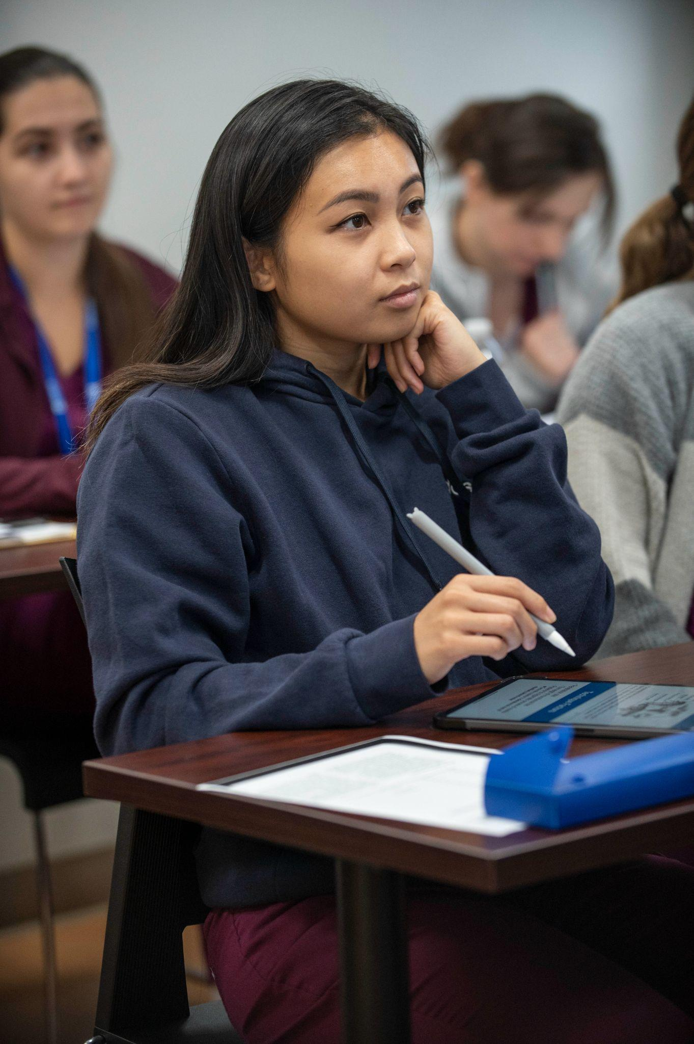
You Belong Here
Attend Class Like You Mean It
Arrive early – be ready to learn on time.
Avoid absences, know the attendance policy for each class
Prevent Distractions
Select a seat where you can see and hear
Take out earbuds/remove headphones
Silence cell phones
If using a computer, open your browser only to tabs relevant to class
Ask questions. Respond when your instructor asks questions.
Take notes: don’t rely only on provided PowerPoints and outlines.
Refer to the syllabus and Canvas often: they are your course guides
Week 1 (9/3) & 9 (10/28)
Refer to Important Course Information Module in Canvas for
College Resources and Policies
Notes:
Project at Start of Class – Weeks 1 and 9, or whenever appropriate.

Slide 4
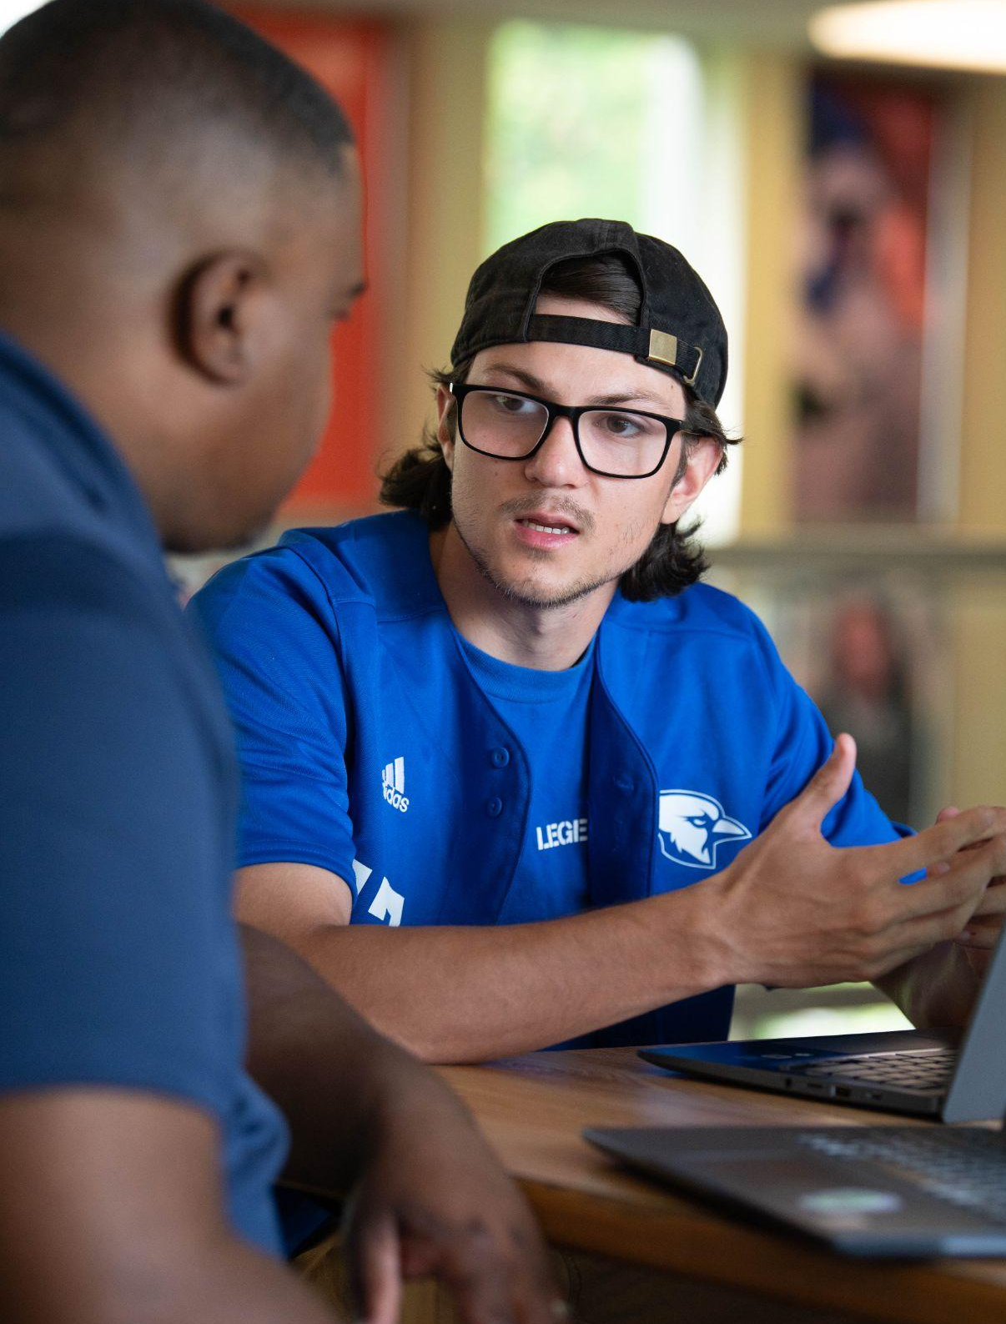
You Belong Here
Time Management!
Effective time management lowers stress and improves performance!
Plan study time: 1 class hour = 2 to 3 out-of-class study and prep hours (this includes hybrid and online).
Schedule your time/use a calendar: class time, homework, commuting, work, social, self-care.
Time Management is the #1 student challenge – get help!
Your professors
Manor College Learning Center
Your Academic Advisor
Campus Counselor
Week 2 (9/9) & 10 (11/4)
Refer to Important Course Information Module in Canvas for
College Resources and Policies
Notes:
Project at Start of Class – Weeks 2 and 10, or whenever appropriate.

Slide 5
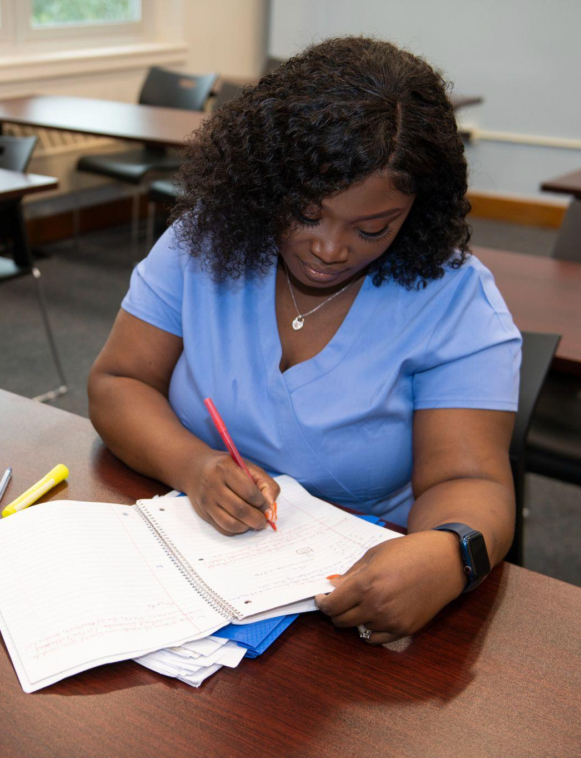
You Belong Here
Submit Assignments…On Time
Homework matters for:
Final grade
Success on larger projects and exams
Submitting work after the deadline can result in:
Reduction in grades (varies by professor)
Falling behind
Pay especially close attention to due dates in online and hybrid courses
Unexpected emergency?
Contact instructor as soon as possible
Week 3 (9/16) & 11 (11/11)
Refer to Important Course Information Module in Canvas for
College Resources and Policies
Notes:
Project at Start of Class – Weeks 4 and 12, or whenever appropriate.

Slide 6
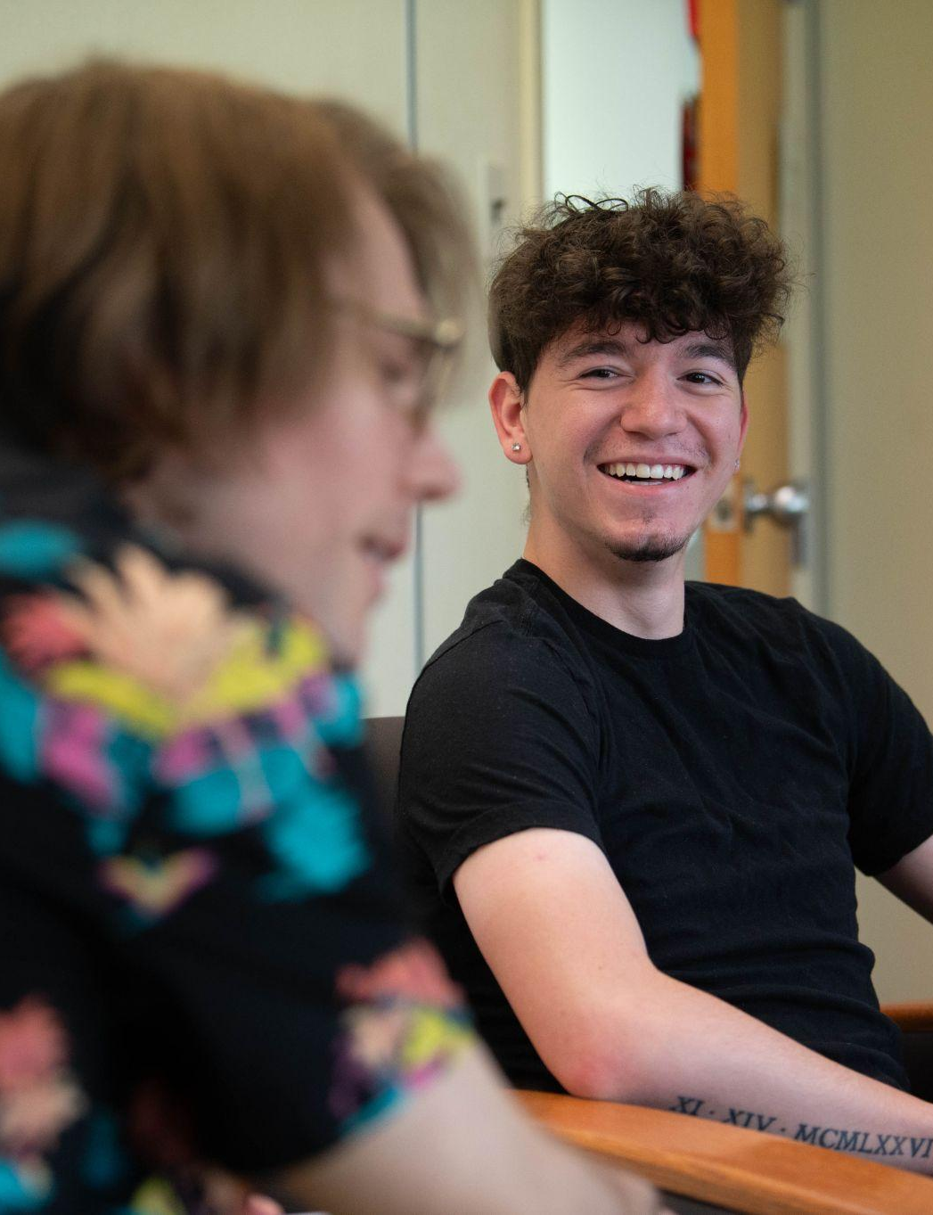
You Belong Here
Seek Academic Help
First – talk to your professor!
Go to the instructor’s office hours
Contact the Learning Center for tutoring help Michael Blose – mblose@manor.edu
Contact a librarian for research help Sarah Baum – sbaum@manor.edu
Connect with Disability Services for academic accommodations
Anessa Rodriguez – arodriguez@manor.edu
Problems with Registration? Paying your Bill? Account holds? Contact Assistant Director of Student Accounts – studentaccounts@manor.edu
Week 4 (9/23) & 12 (11/18)
Refer to Important Course Information Module in Canvas for
College Resources and Policies
Notes:
Project at Start of Class – Weeks 5 and 13, or whenever appropriate.

Slide 7
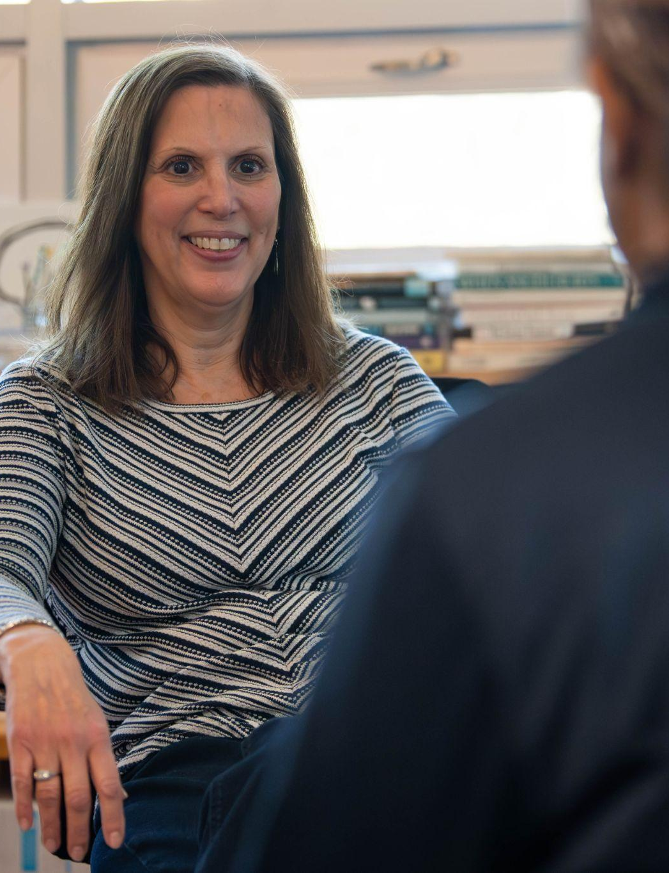
You Belong Here
Take Care of You…All of You!
Get enough sleep!
Exercise – even moderate exercise helps
Attend class hydrated and nourished
Use your Student Health Center
Jen Winters – jwinters@manor.edu
Consult with Counseling Services
Christie Prince – cprince@manor.edu
Spend time with friends, families, pets, etc.
Plan downtime!
Week 5 (9/30) & 13 (11/25)
Refer to Important Course Information Module in Canvas for
College Resources and Policies
Notes:
Project at Start of Class – Weeks 3 and 11, or whenever appropriate.

Slide 8
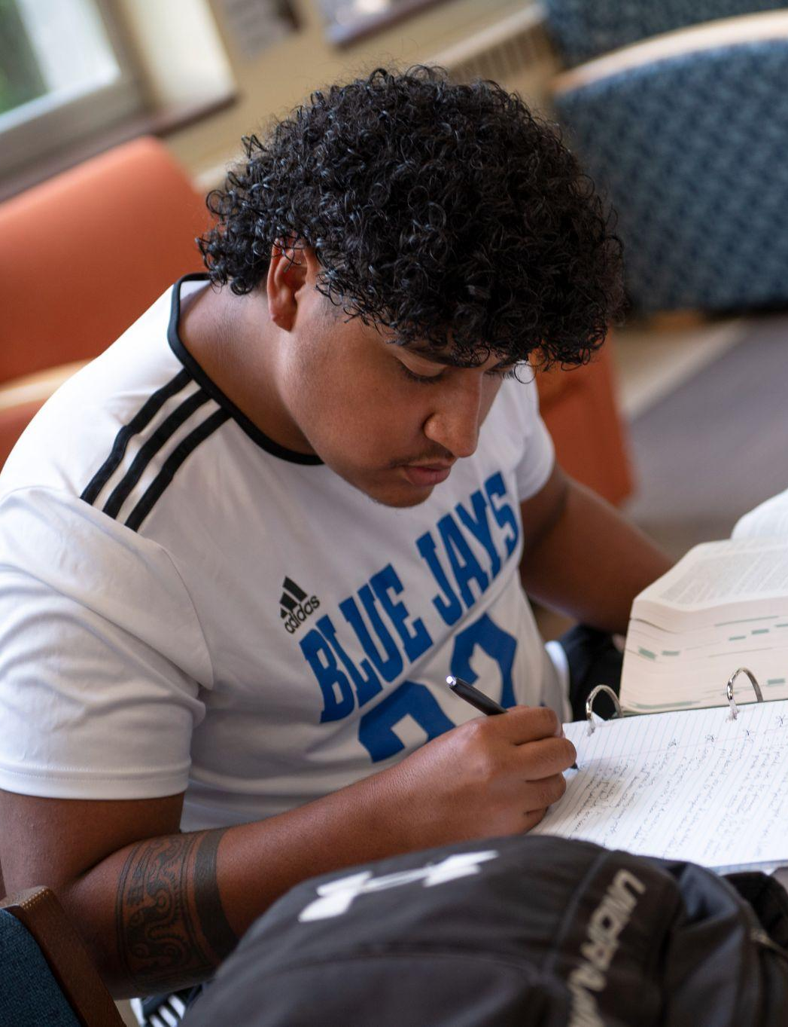
You Belong Here
Deal with Absences Effectively
Avoid absences: Make sure you understand the absence policy in each class - - they may not all be the same!
If you are absent:
Let your professors know in advance
Complete and submit assignments that are due
Don’t ask “Did I miss anything?” Get notes from a reliable classmate… ask Professor “What did I miss?”
If you will need to be out for an extended time, contact Sharon Madden in the Provost’s Office (smadden@manor.edu or extension 1243)
Week 6 (10/7) & 14 (12/2)
Refer to Important Course Information Module in Canvas for
College Resources and Policies
Notes:
Project at Start of Class – Weeks 6 and 14, or whenever appropriate.

Slide 9
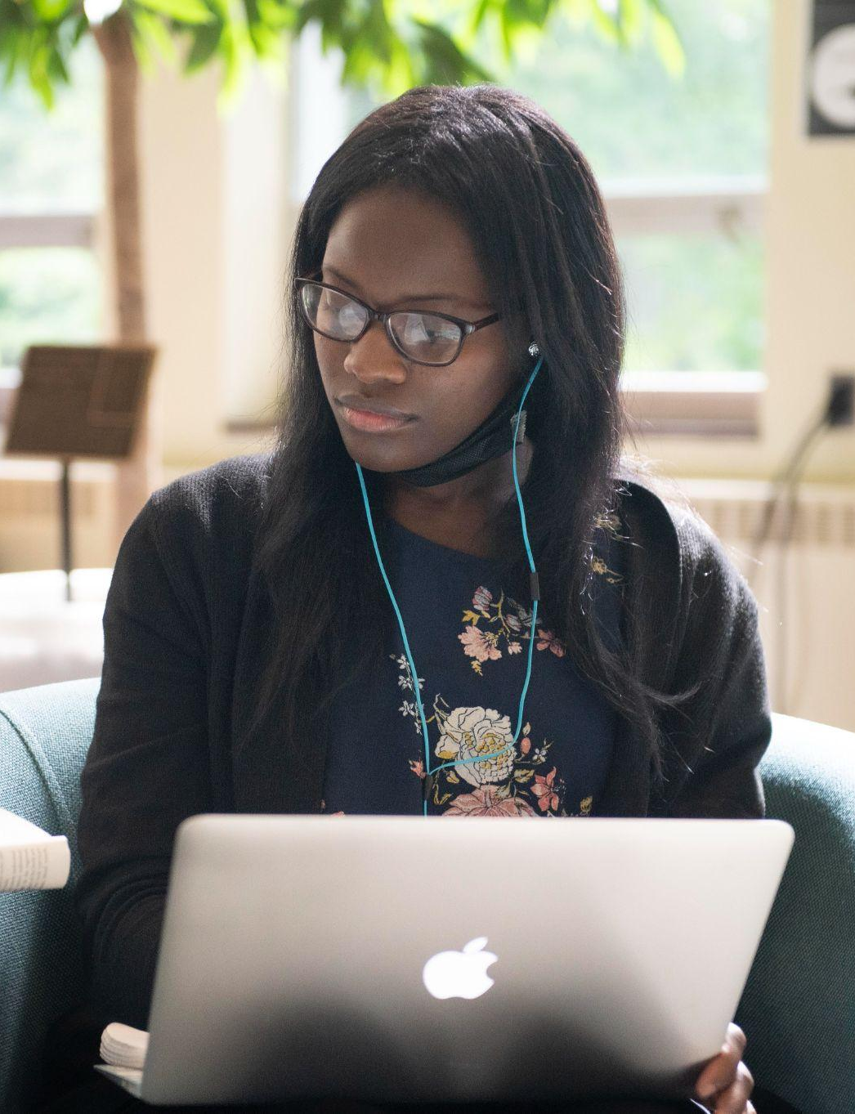
You Belong Here
Know Yourself
Have a study plan: where you are most effective (library? cafe? kitchen table?)
Plan your time:
Night owls? Avoid “wait until morning”
Early Bird? Get it done before dinner
Learn best collaboratively? Set up study groups
Work well under pressure? Make sure to set aside time to get the work done.
Week 7 (10/14) & 15 (12/9)
Refer to Important Course Information Module in Canvas for
College Resources and Policies
Notes:
Project at Start of Class – Weeks 7 and 15, or whenever appropriate.

Slide 10
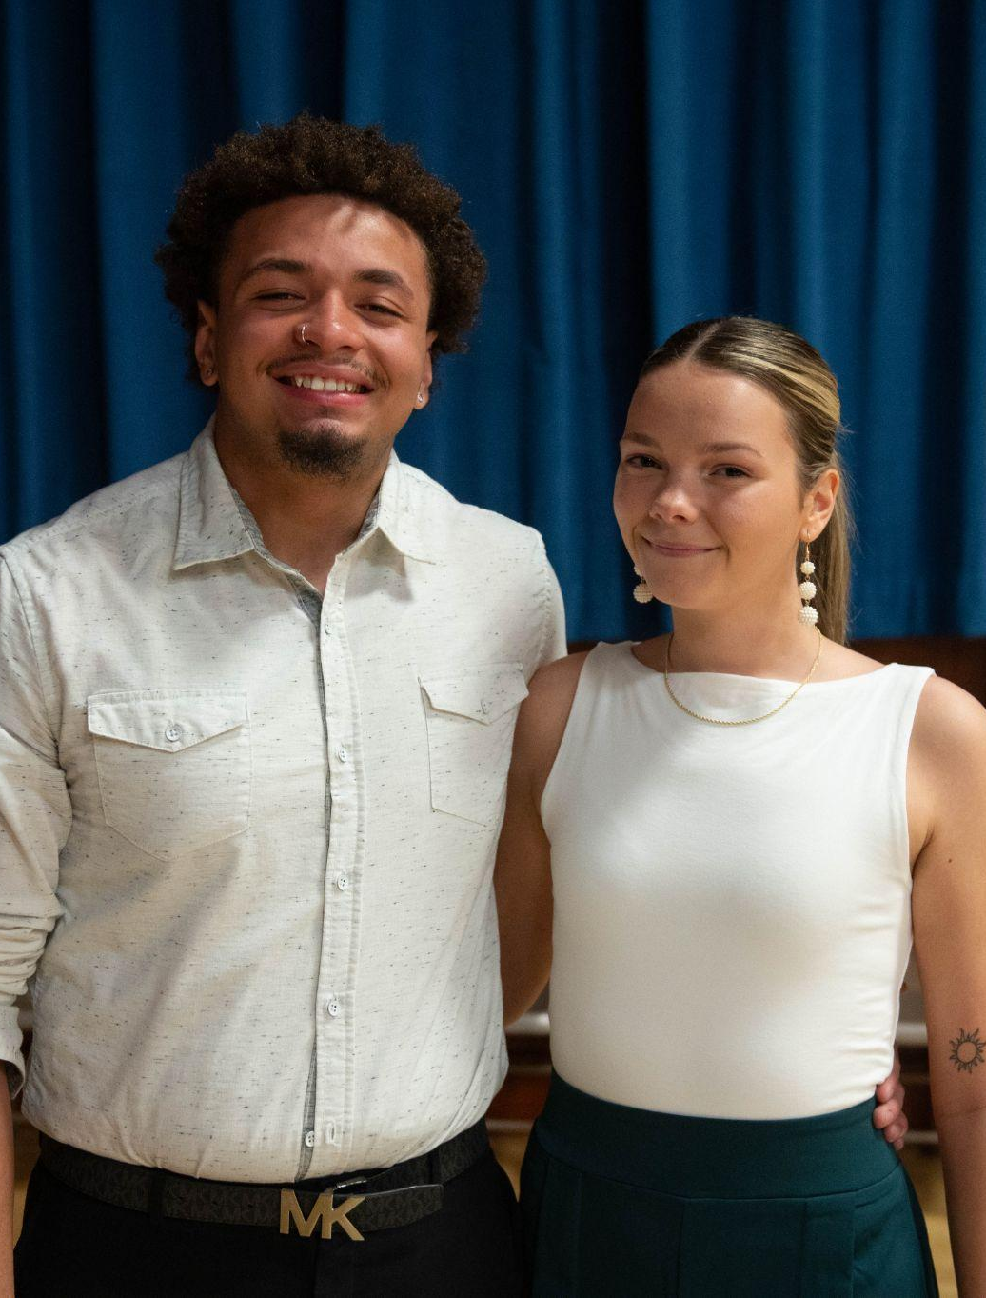
You Belong Here
Make Your Own Community
College is more than just going to class
What to do?
Navigate to manor.edu
Click on Student Life (top right)
Click on Student Engagement (bottom left)
Select Student Clubs and Organizations from the drop down
Remember: If you don’t see what you want, you can create your own club (use the form at the bottom to share your ideas)
Week 8 (10/21)
Refer to Important Course Information Module in Canvas for
College Resources and Policies
Notes:
Project at Start of Class – Week 8 or whenever appropriate.

Slide 11
You Belong Here Campaign
Questions?
Be in touch with:
Joe Gillespie, Provost
jgillespie@manor.edu
215-885-2360 ext. 1223
Elinore Leonards, Director of Student Success
eleonards@manor.edu
215-885-2360 ext. 1239

