Slide 1
Setup a student test appointment for the testing center
Guided with screenshots

Slide 2
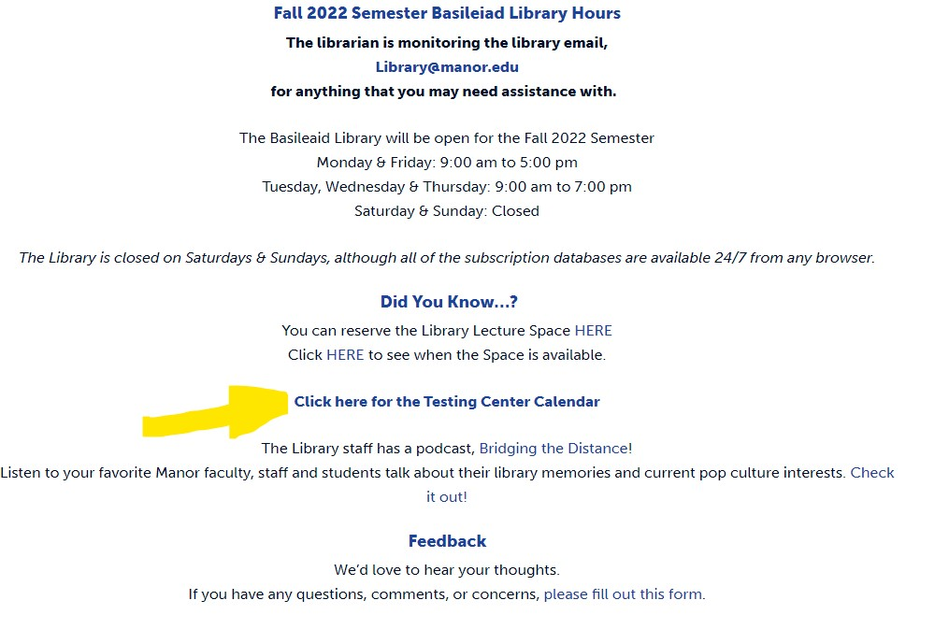
Steps one and Two:
Go to the Library Web Page
(www.manor.edu/academics/library/)
2. Click the Link for Testing Center calendar

Slide 3
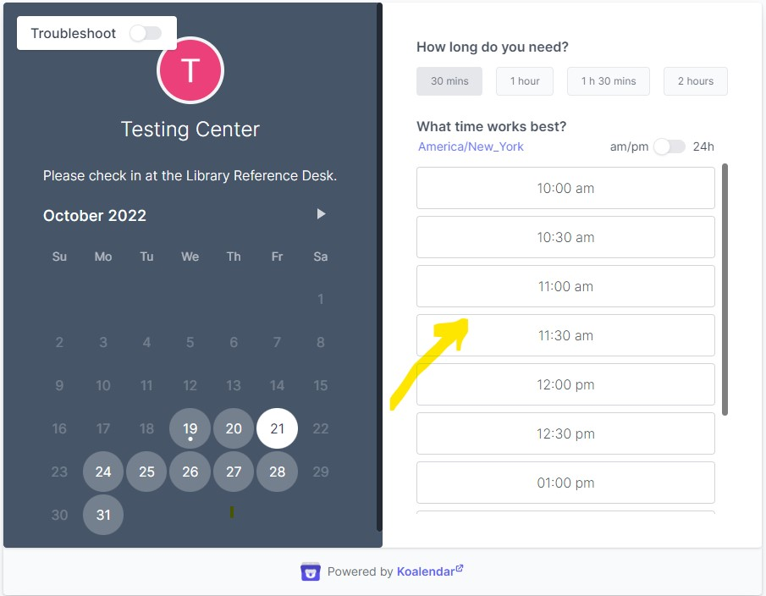
Steps three: appointment
3. appointment screen: click on the desired time

Slide 4
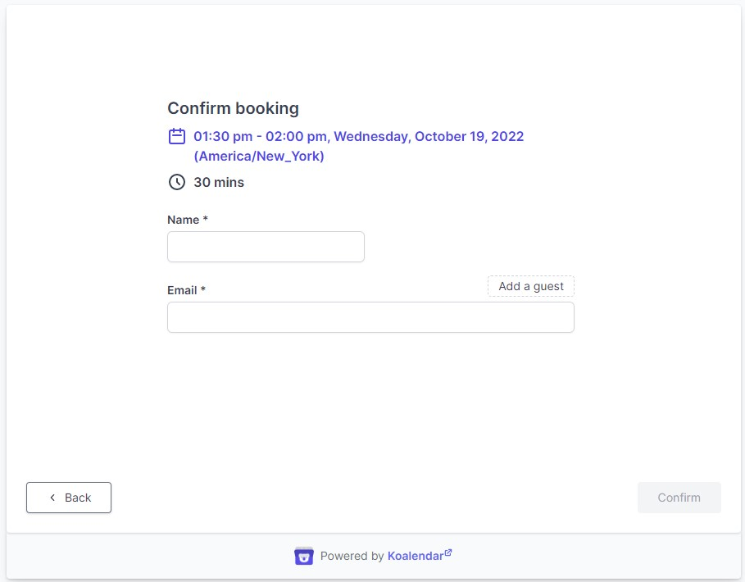
Step Four: What you’ll see
4. Confirm your selection- (IF YOU NEED TWO HOURS SIGN UP FOR TWO CONSECUTIVE BLOCKS). Confirm your selection by clicking “CONFIRM.”

